Slide 1

PSUCampus Navigator Presentation
Tuesday, October 21, 2025

Slide 2
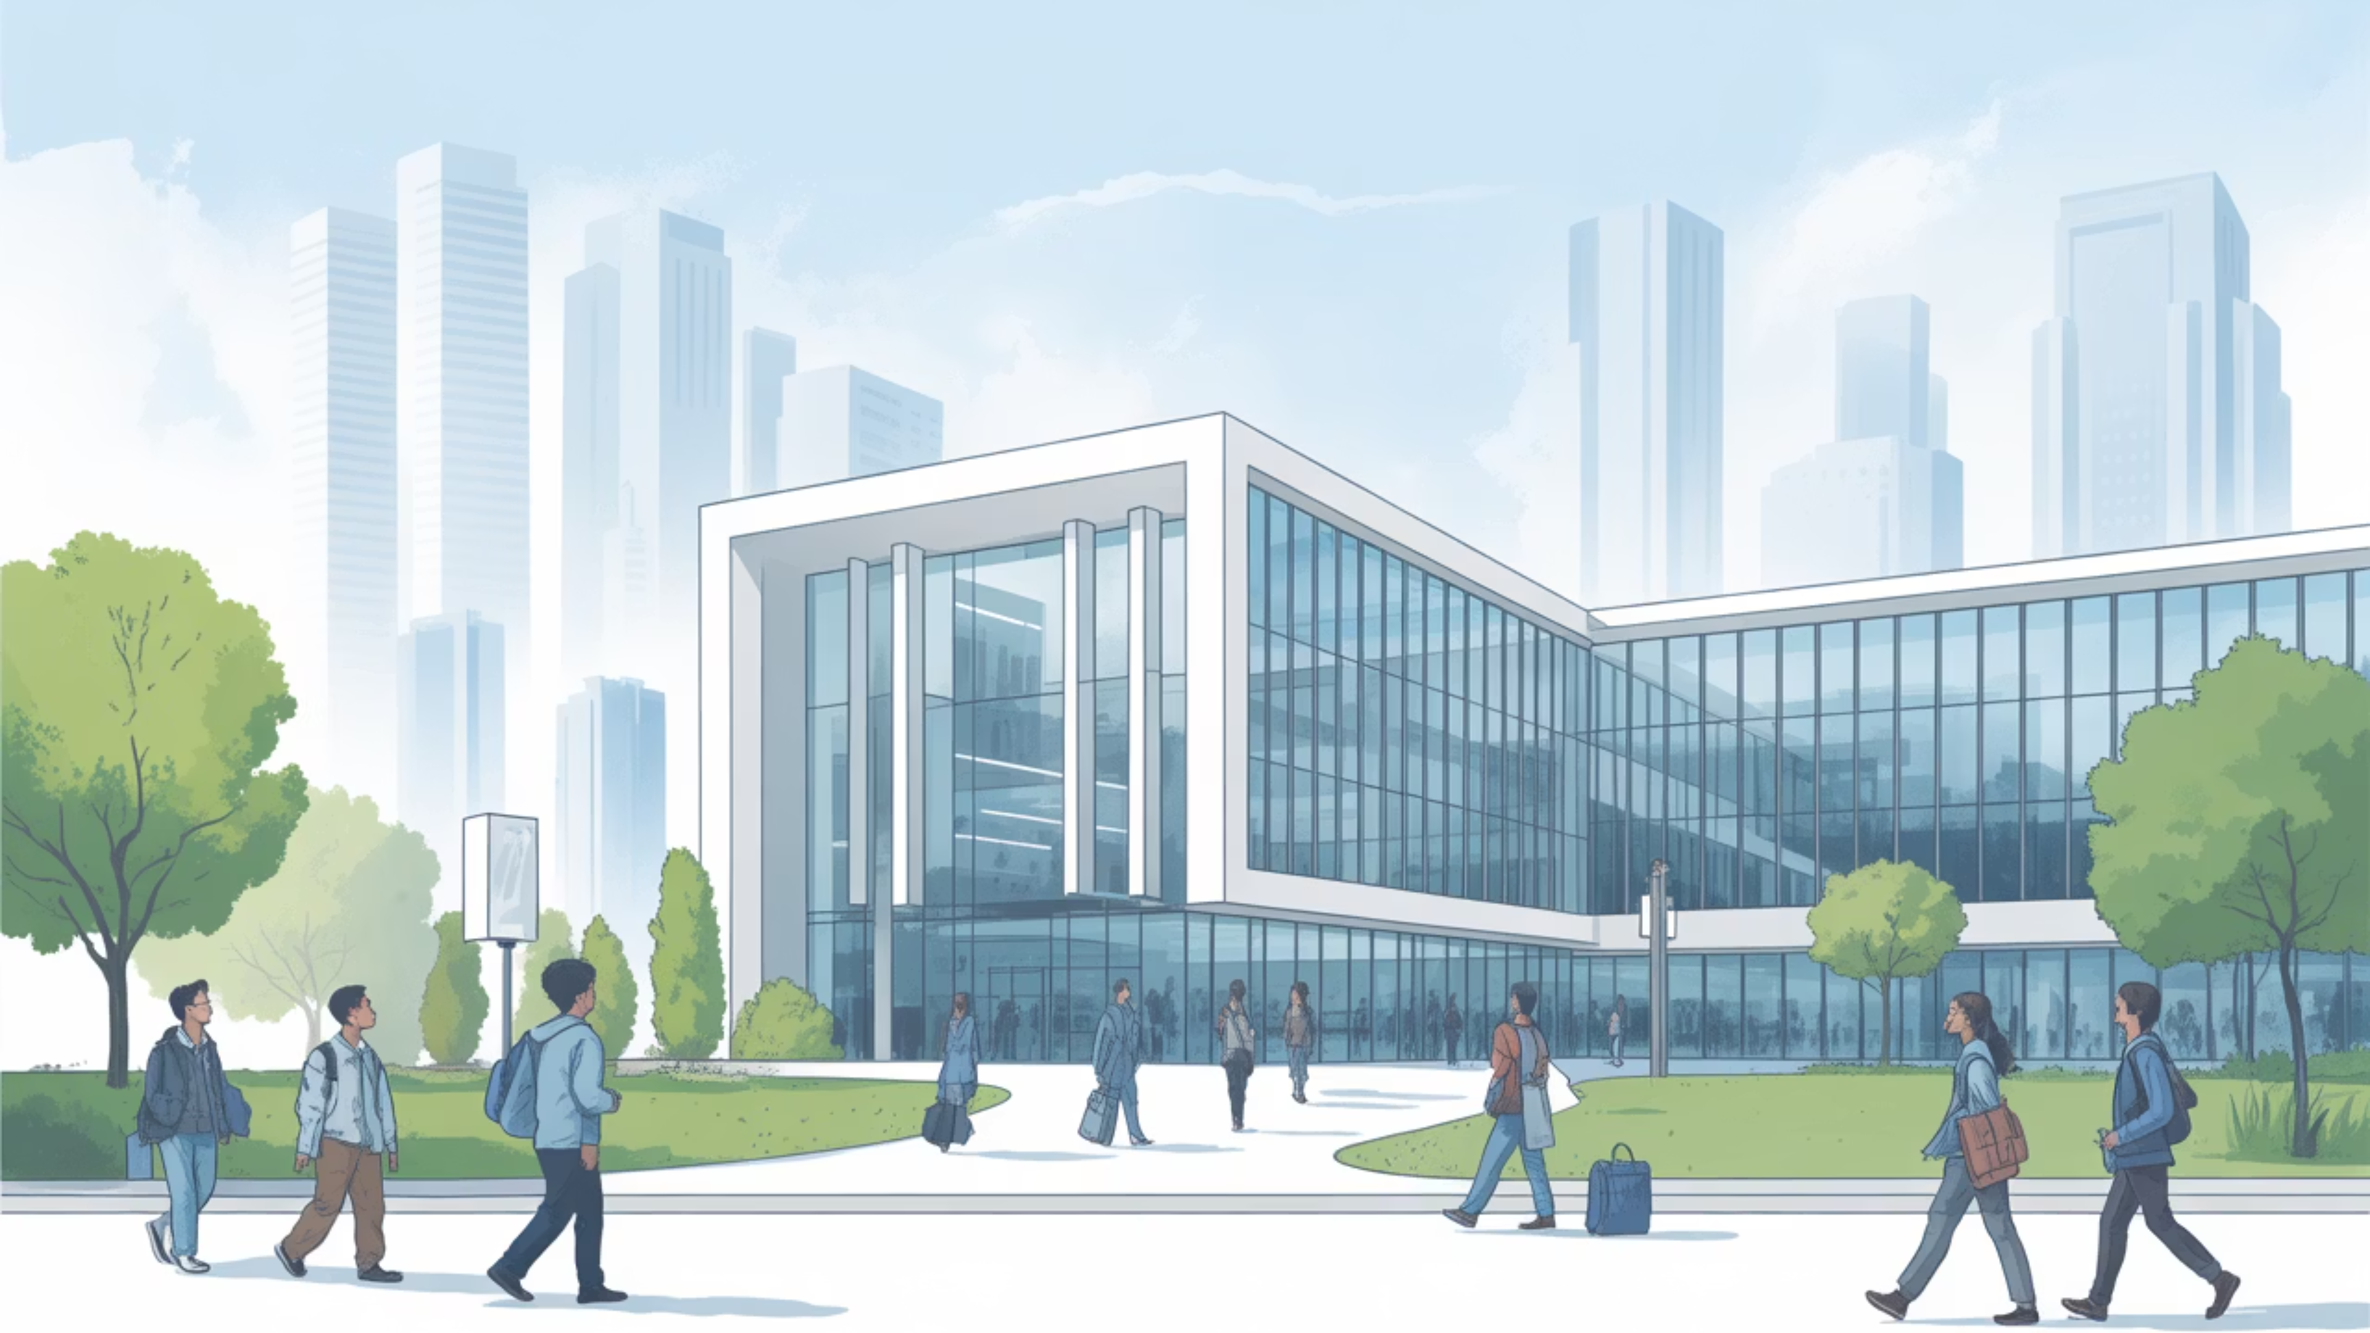
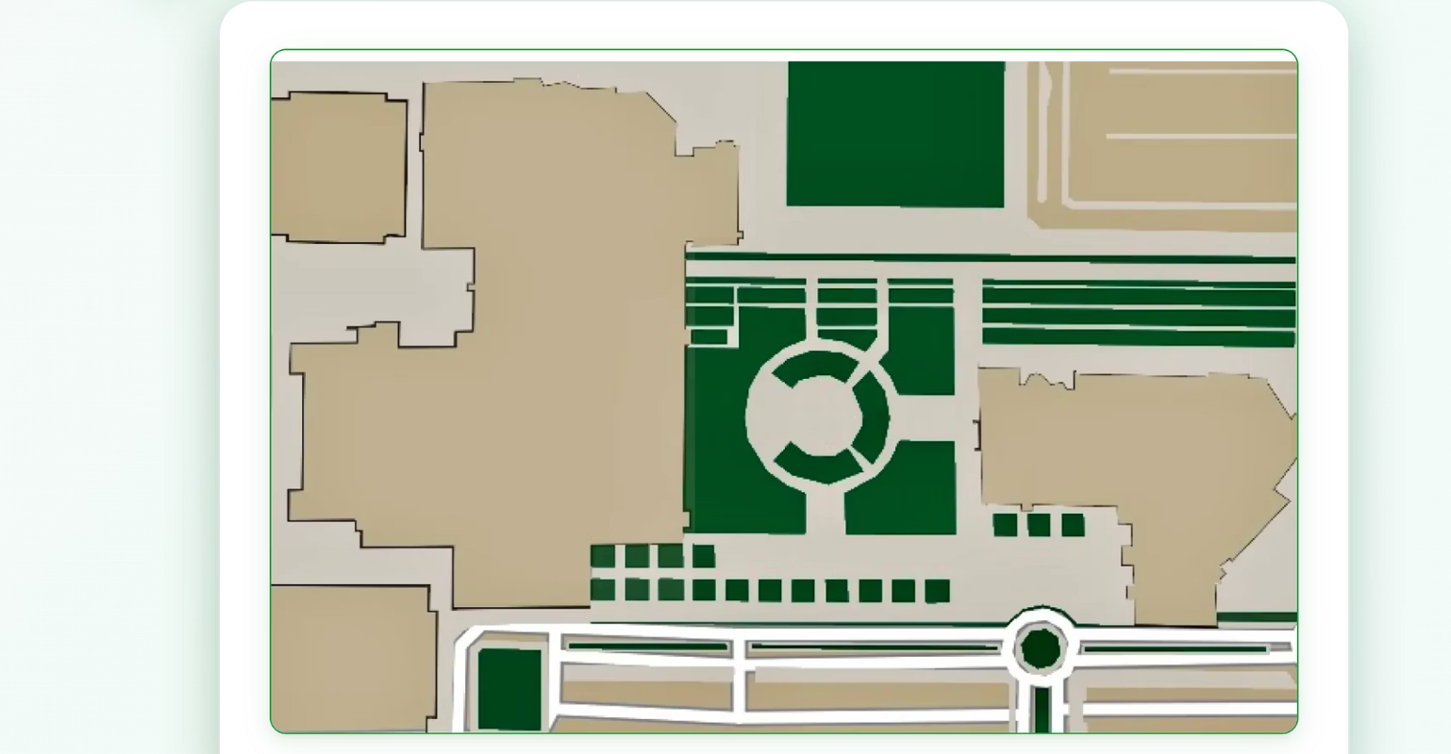
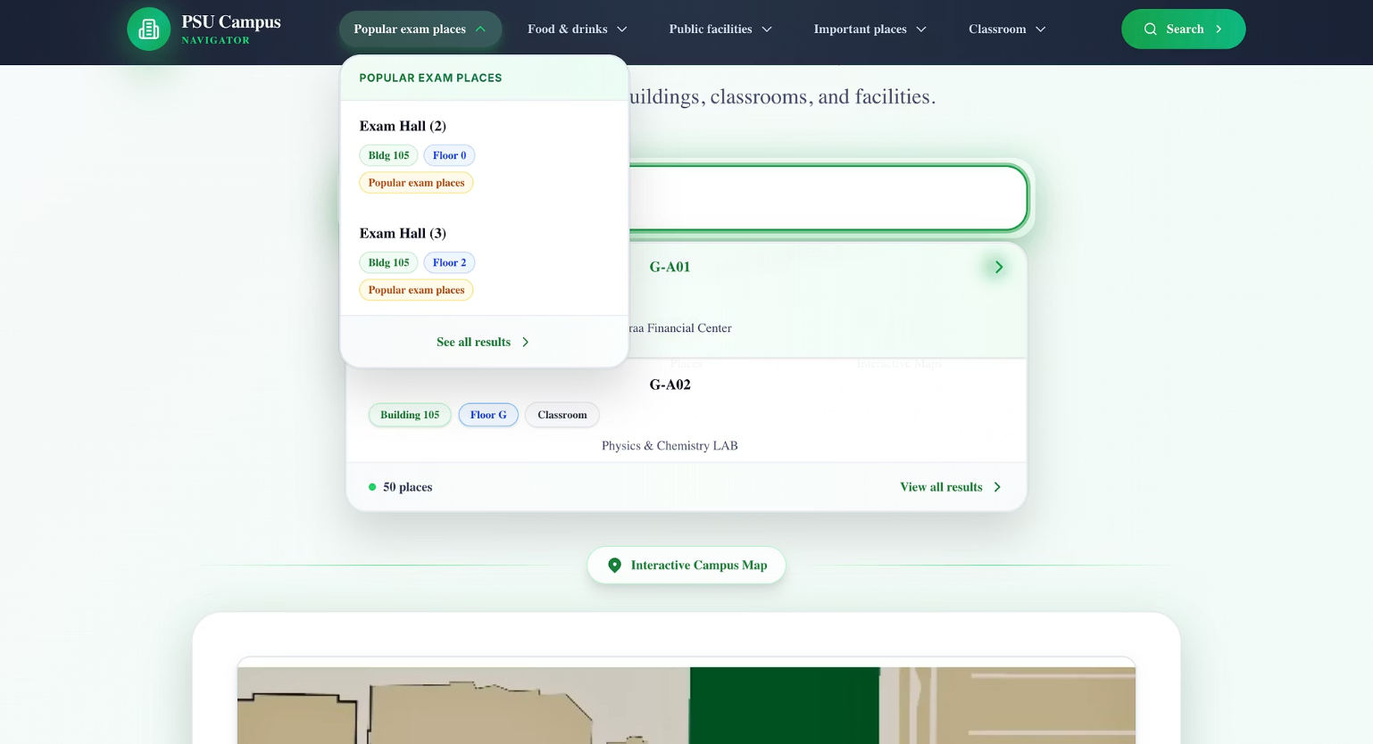
Current Progress - Home
Press each building will lead you to the building
Search for your Desired class or chose on of the categories

Slide 3

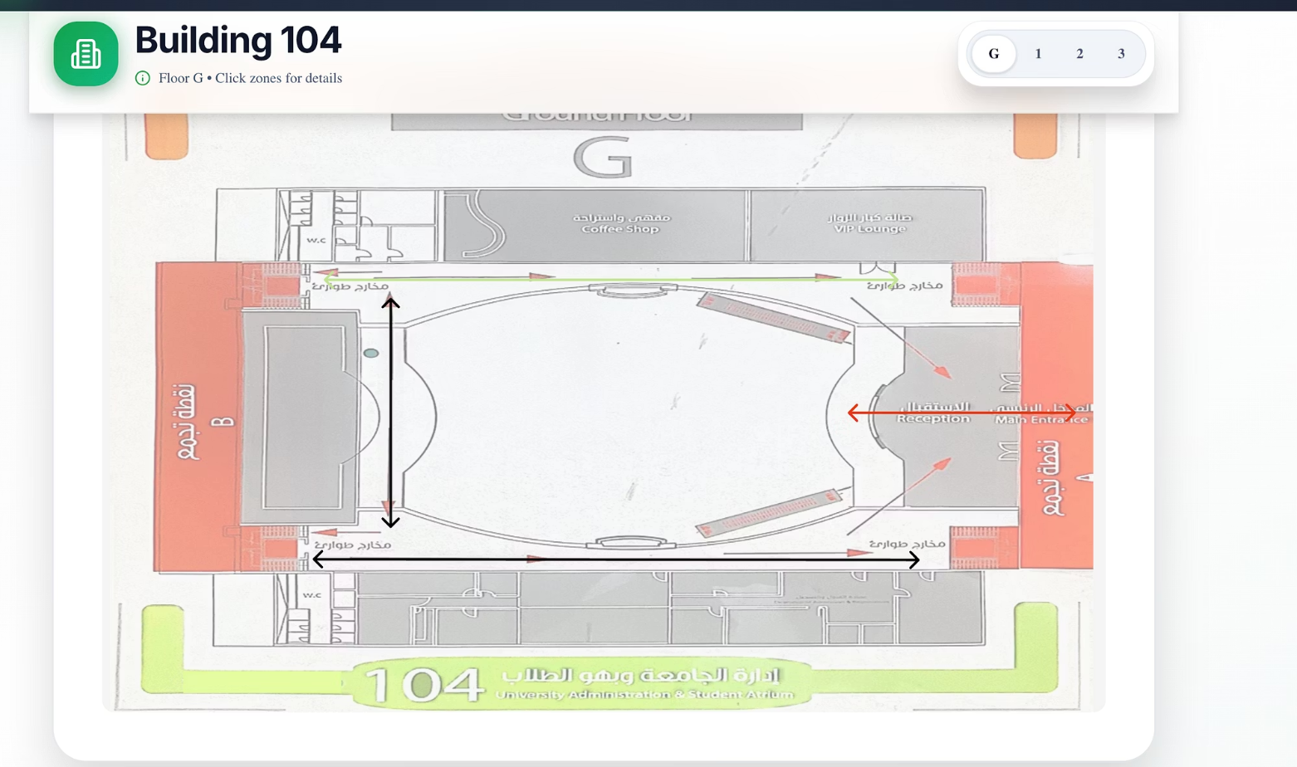
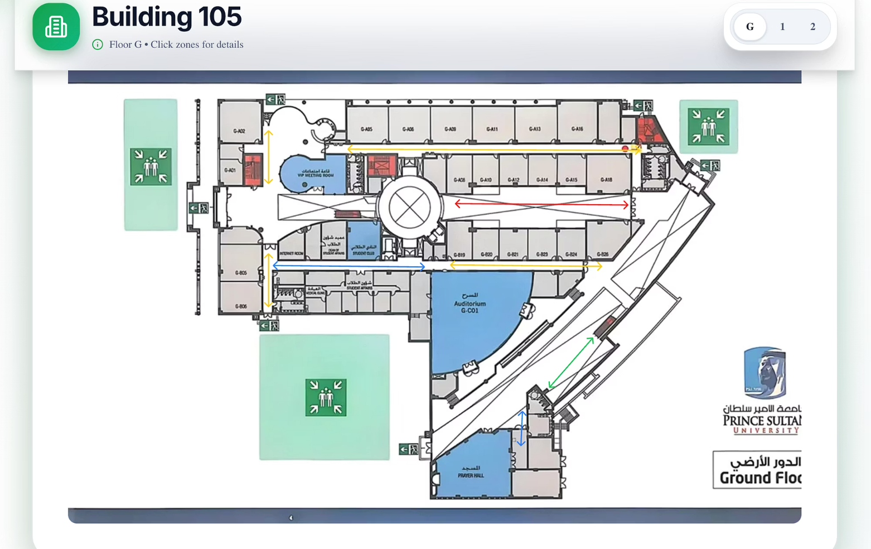
Current Progress - Buildings 104 and 105
Building 104 map
Building 105 map

Slide 4
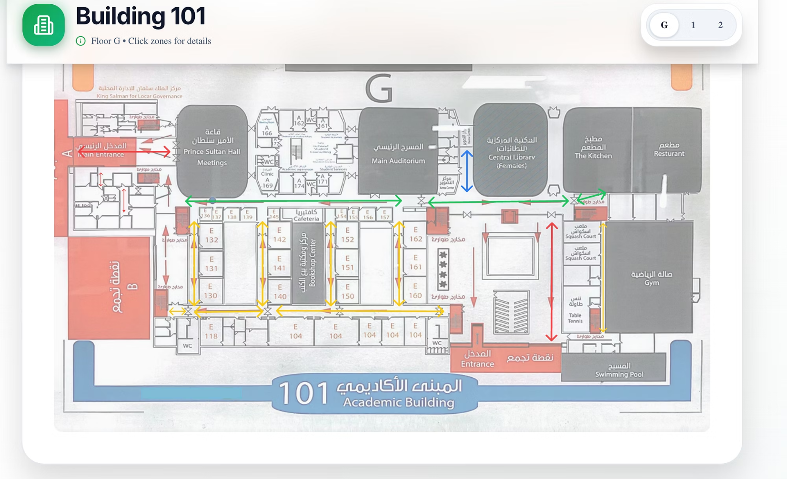
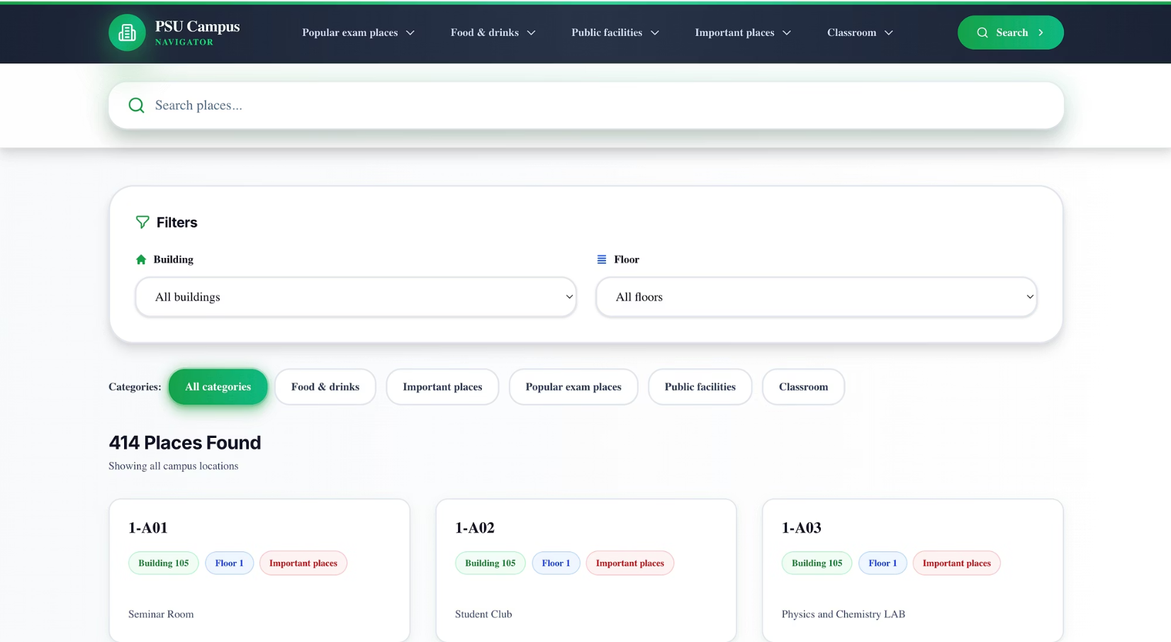
Current Progress - Buildings 101 and Search page
Map for building 101
You can by search by place name or by choosing building category and floor

Slide 5
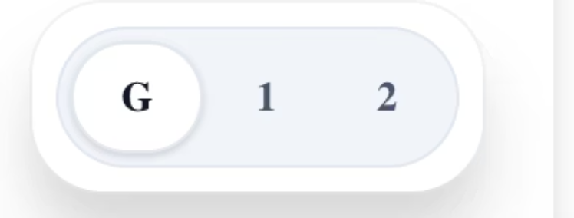
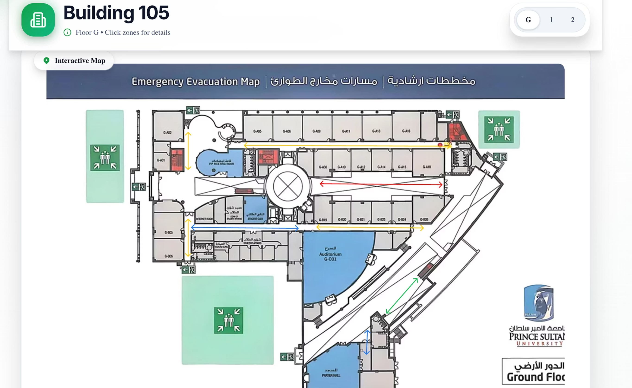
floor maps
press the floor map buttons to change to the desired floor m app

Slide 6
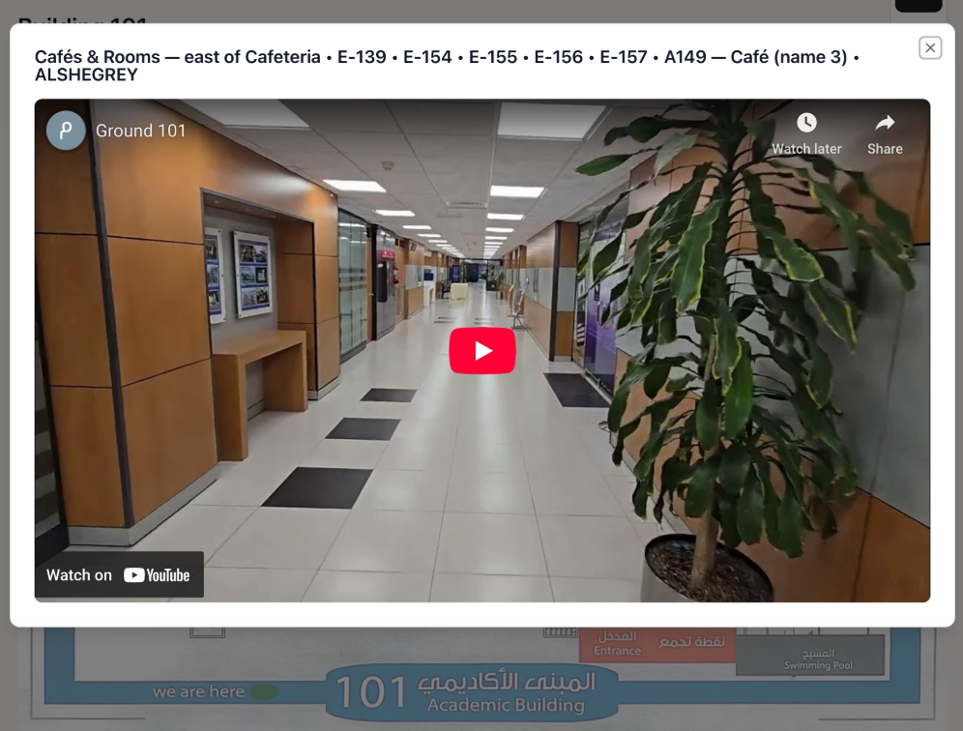
Embedded videos
1
2
3
Press on the arrow to show the video

Slide 7
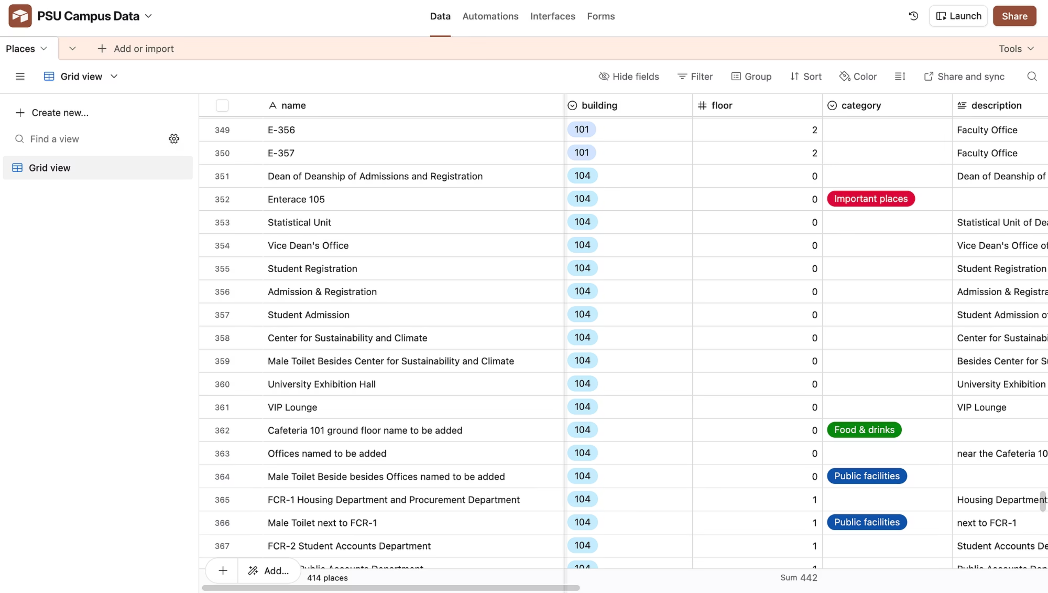
Data - admin log in
Real-time Sync & Server Load Reduction
Place Changes Log
Air table reduce the load on the server and give an easy way to edit pages with real time sync with the website
Changes to places happened her

Slide 8

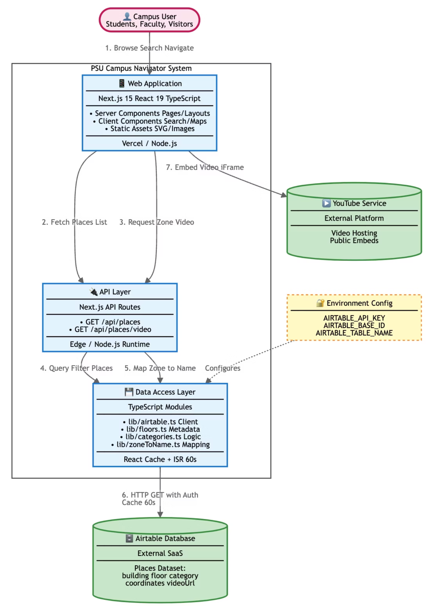
C4 Container Diagram
diagram shows the high-level shape of the software architecture and how responsibilities are distributed across it.
It also shows the major technology choices and how the containers communicate with one another

Slide 9

Blockers /risk
1
2
Limited filming windows
Airtable dependency
→ shot list + backup slots.
→ cache fallback + weekly backups.
3
4
Privacy in hallway videos
Small team & scope creep
→ avoid faces; blur/remove on request.
→ strict scope; daily stand-ups.

Slide 10

Next Steps
1
Add the reamaining video to the website
additional sprint to polish the website
2

